Slide 1
A Robotics Simulation of Krusty Krabs Restaurant
AI Planning for Robot Systems
24CSAI04H
amir224030, merihan226392
omar228248, sameh218767
Part 2

Slide 2
TABLE OF CONTENTS
01
Overview
02
03
Design Decisions
RL Algorithm
Objectives, Features and Envionment
DDQN and Training
Architecture and Hyperparameter-tuning
04
05
06
Conclusion
Reward
System
Comparison and Results

Slide 3
Overview
The project involves designing a simulation where an agent, Mr. Krabs, uses a Double Deep Q-Network (DDQN) to navigate a complex environment with obstacles and locate target money. Through RL, the agent optimizes its decisions by leveraging rewards and penalties, learning to balance exploration and exploitation.
Note: it should’ve been Plankton trying to steal the secret formula but we forgot :(

Slide 4
Objectives and Features
▪Define a proper reward system suitable enough to nature of the environment that can incentivize the agent to find the money in an efficient and timely while avoiding static obstacles all around.
Implement a DDQN algorithm to train a single agent to navigate his environment and reach the specified target efficiently.
Successfully train the agent to locate and reach the intended target within the environment using exploration and exploitation strategies.

Slide 5
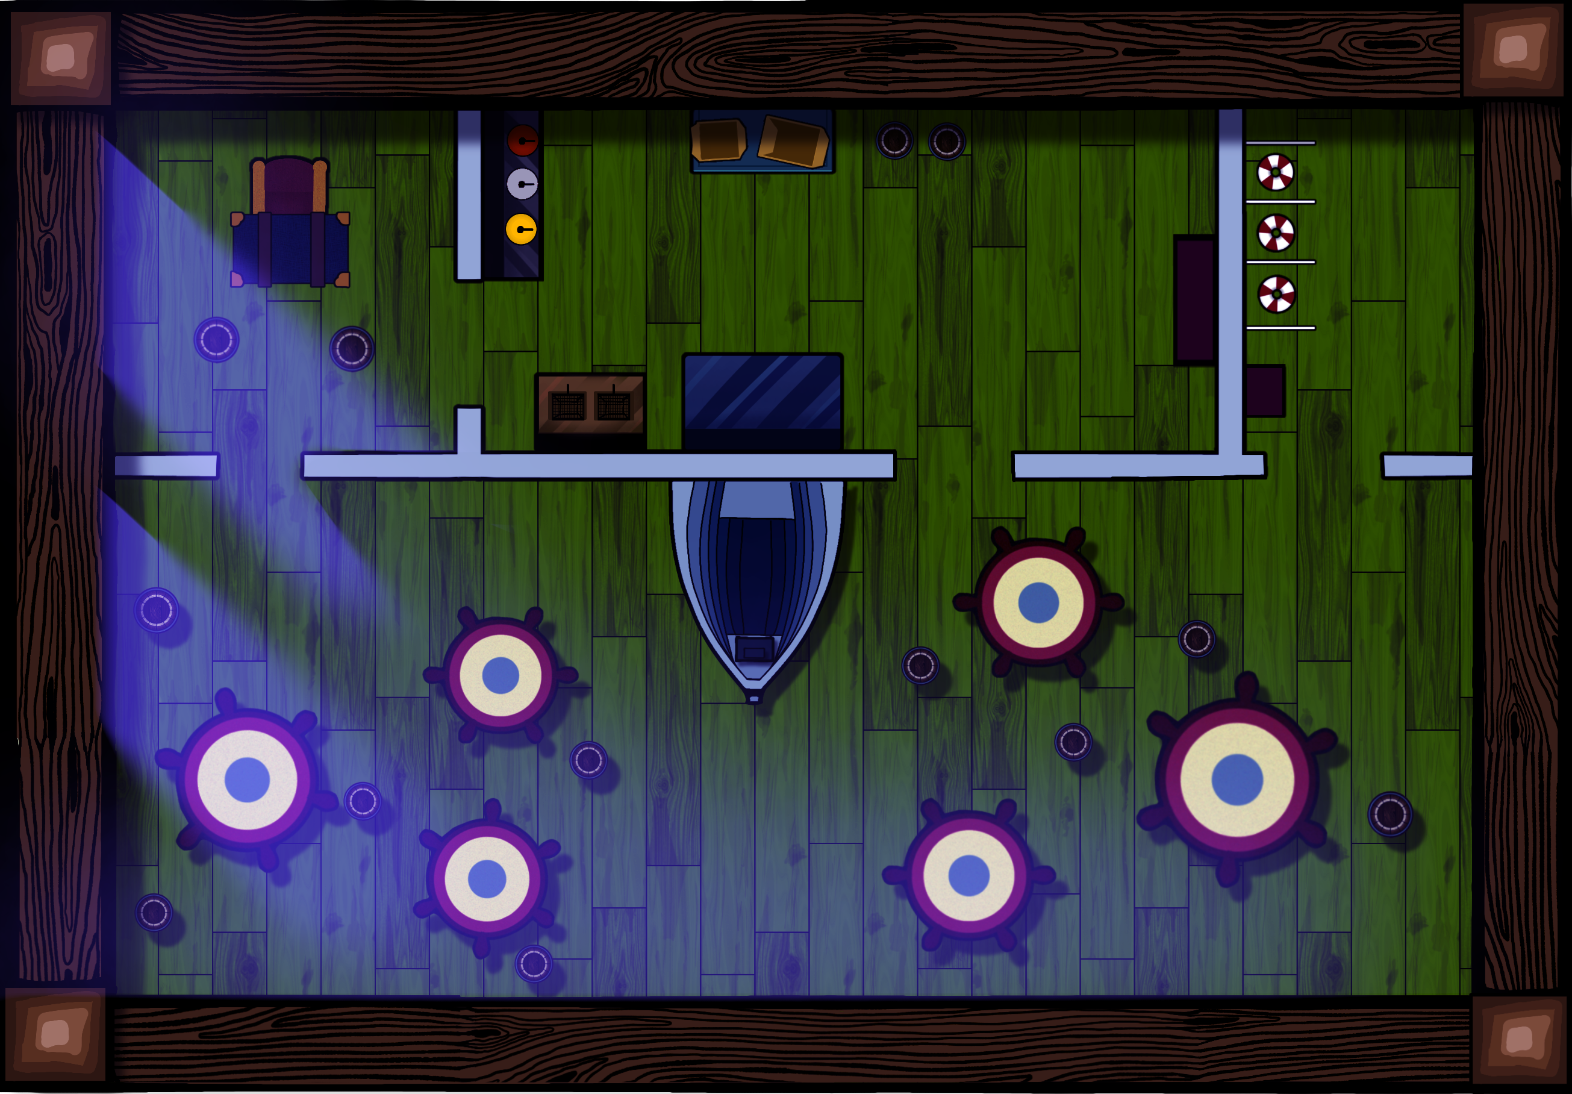



Environment At Night
No Dynamic Obstacles
Agent
Static Obstacles
Target

Slide 6

RL Algorithm
Initially, we used Deep-Q-Network (DQN) and its simpler counterpart QN before it as the algorithms of choice. However, due to the inherent complexity of our environment, being a 238 by 165 grid, in addition to the obstacles as well as training problems we faced, we ended up utilizing Double Deep Q-Network (DDQN).

Slide 7
RL Algorithm (DDQN)
Stores past experiences to break sequential data correlations.
Epsilon-greedy exploration balances exploration and exploitation.
Loss function minimizes error between target and predicted Q-values.
Prevents Q-value overestimation for better stability and accuracy.
Utilizes two networks: policy (action selection) and target (stable Q-value training).
Avoids overestimation by separating action selection and evaluation.

Slide 8
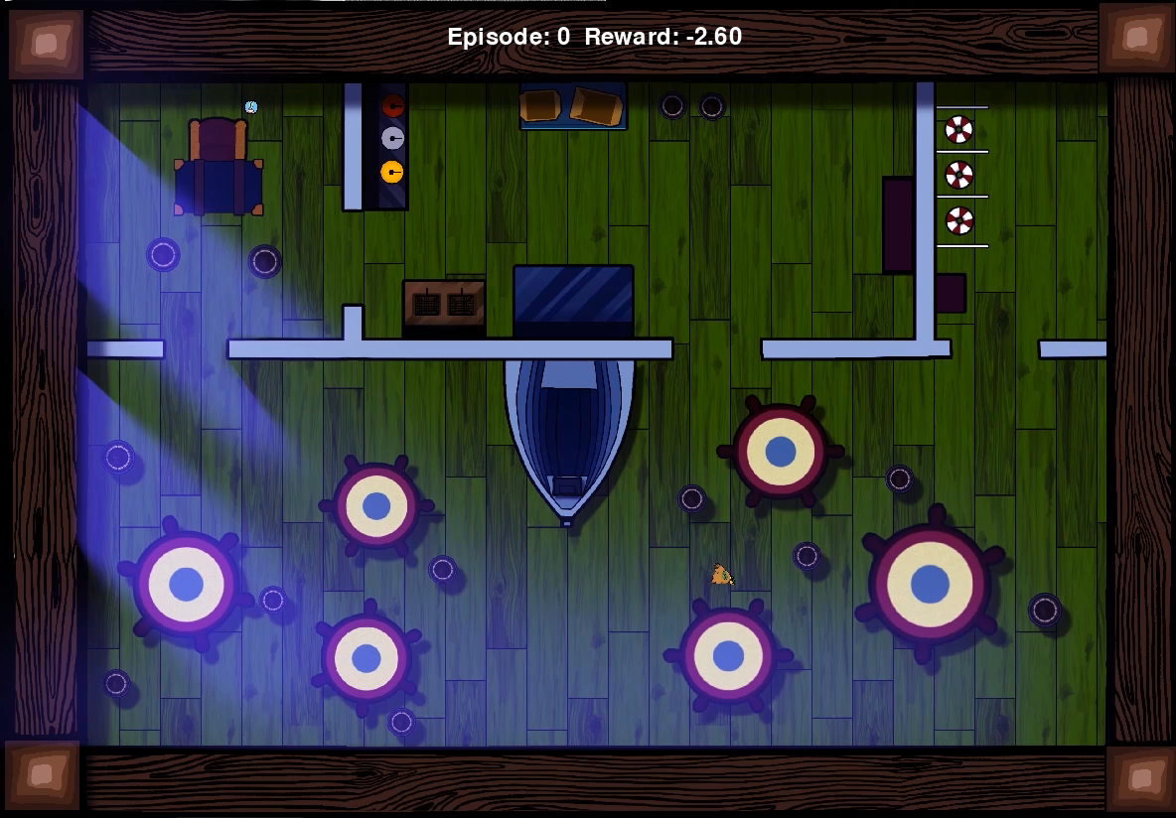
RL Algorithm (Training)
The training was conducted on 130 episodes, 500 steps each. We utilized an epsilon decay strategy rather than a linear one for early convergence. Both total reward and successful target achievement have been recorded.
165
238

Slide 9



Slide 10
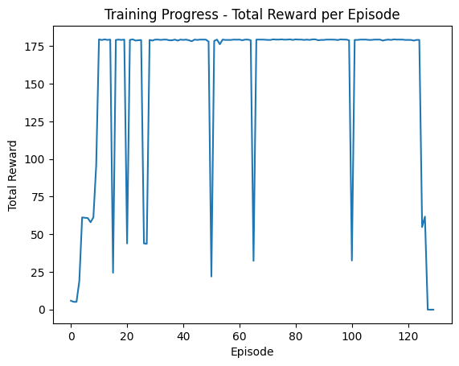
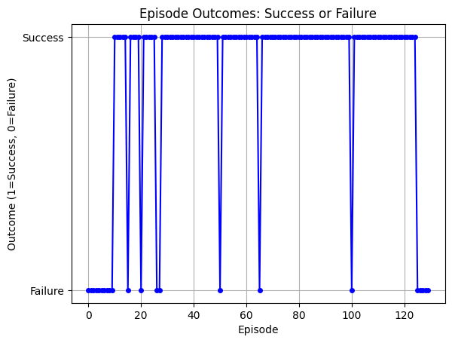
Training Results

Slide 11
Design Decisions
NN Architecture
Hyperparamter-tuning

Slide 12
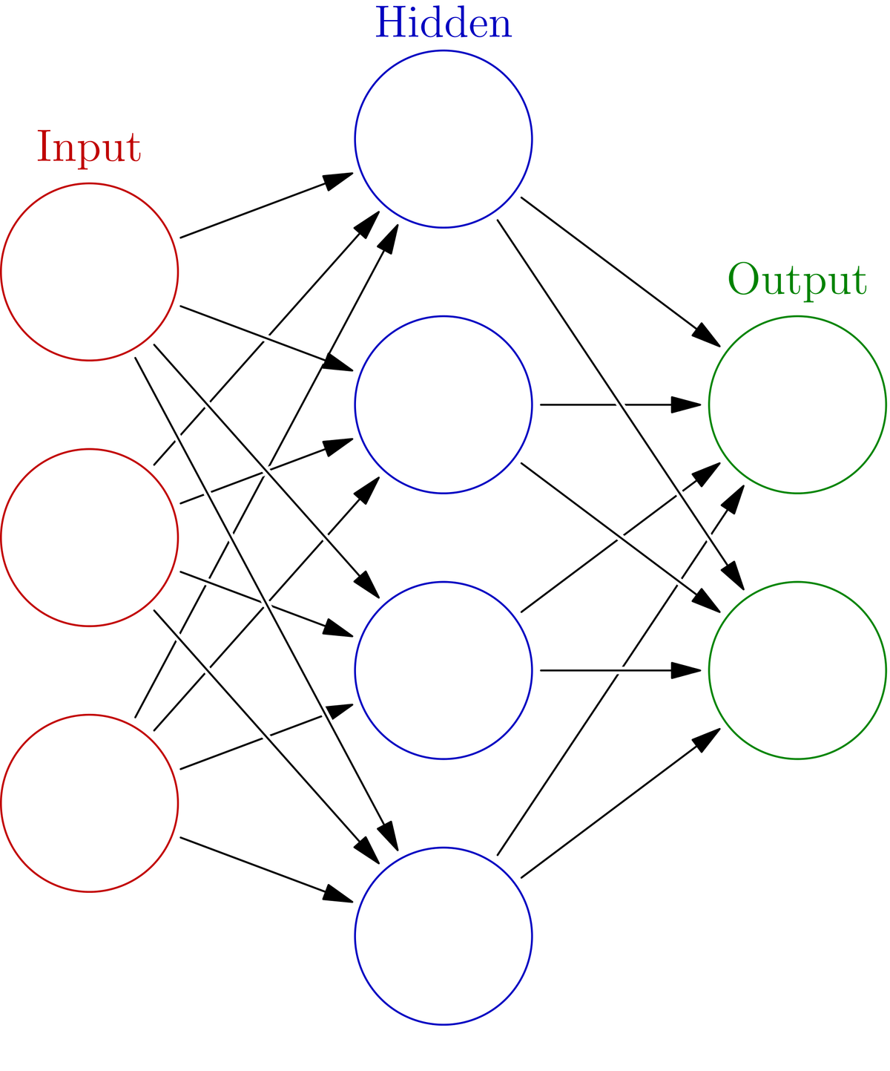
Neural Network Architecture
A feedforward network with 3 hidden layers, each containing 64 neurons and ReLU activation. This design provides sufficient capacity for learning complex state-action mappings without being overly complex.

Slide 13
Hyperparameter-Tuning
Target Network Updates: Every 100 episodes for stability and alignment.
Replay Memory Size: 100,000 to ensure stable training and avoid policy degradation.
Batch Size: 32 for efficient information capture.
Learning Rate: 0.0001 to minimize oscillations and ensure gradual learning.
Epsilon-greedy: Shift from exploration (EPS_START = 1.0) to exploitation (EPS_END = 0.01) over the course of training with a decay rate (EPS_DECAY = 0.998) for steady learning.

Slide 14
Reward System
Pnealties
Rewards
Moving Away: -0.15 penalty for increasing distance to the target.
Excessive Steps: -0.01 penalty per step to discourage unnecessary movements.
Collision: -5.0 penalty, ending the episode immediately.
Reaching Target: +50.0 reward for reaching the goal.
Progress: +Δd reward, the reduced Euclidean distance between agent and the target.

Slide 15
Comparison and Results
We compared the algorithms based on time elapsed (in seconds) as a measure of efficiency. To equal the playing fields, there were neither dynamic obstacles nor mapping to properly capture their full potential in the ideal scenario. Additionally, all algorithms were given the same starting points as well as the same end point to reach one target. The results are shown below:

Slide 16
Comparison and Results
 | Time Elapsed (s)
A* | 5.47
DIJKSTRA | 5.54
DDQN | 5.37

Slide 17
Conclusion
Thank
You
The results show that a properly trained DDQN agent can navigate our environment slightly better and faster than traditional search algorithms such as A* and Dijkstra. However, one thing to keep in mind is the complexity and overall time it takes to train said model in the first place. Additionally, the circumstances would skew the results dynamic obstacles were introduced in different scenarios.

